Slide 1
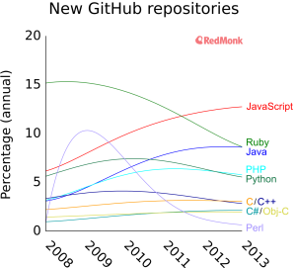
Programming Language of Choice

Slide 2
NGS Development

